Slide 1


Wildfire Risk Classification
from Satellite and Weather Data
Predictive Analytics using Machine Learning
TEAM MEMBERS
Anagha C
Savin Jees
V A Sreehari

Slide 2





Problem Statement
Wildfires threaten forests, wildlife & human lives worldwide
Climate change increases wildfire frequency & intensity
3.5M+
Traditional detection methods are slow and inaccurate
acres burned annually
in the US alone
ML can classify wildfire risk early and efficiently

Slide 3

Objectives of the Project
Predict Wildfire Risk
Analyze Meteorological Data
Classify risk levels accurately using ML algorithms
Study weather patterns, humidity, wind, temperature
Compare ML Algorithms
Improve Disaster Preparedness
Evaluate SVM, Random Forest, and XGBoost performance
Enable earlier warnings and better resource allocation
Build Intelligent System
Deploy real-time wildfire prediction via Streamlit app

Slide 4

Dataset Description
Algerian Forest Fire Dataset
UCI Machine Learning Repository | 244 instances | Binary Classification
244
13
2
2
Records
Features
Classes
Regions
KEY FEATURES
Temperature
RH
Ws
Rain
FFMC
Max °C
Humidity %
Wind km/h
Rainfall mm
Fine Fuel Moisture
DMC
DC
ISI
BUI
FWI
Duff Moisture
Drought Code
Initial Spread
Build Up
Fire Weather

Slide 5
Workflow & Methodology
Dataset
Collection
Data
Preprocessing
Feature
Engineering
Train/Test
Split
Model
Training
Streamlit
Deployment
Evaluation
& Metrics
XGBoost
Random
Forest
SVM
80% Training | 20% Testing | StandardScaler Normalization | Label Encoding

Slide 6


Machine Learning Models
SVM
RF
XGB
Support Vector Machine
Random Forest
XGBoost
RBF Kernel (Radial Basis Function)
200 Decision Trees
200 Boosting Rounds
Regularization C = 1.0
Max Depth: 10
Learning Rate: 0.1
Probability estimates enabled
Feature importance scores
Max Depth: 6
Optimal for high-dimensional space
Robust against overfitting
State-of-art gradient boosting

Slide 7
Results & Visualizations
XGBoost achieved best performance with 97.5% accuracy, 0.99 AUC-ROC, and highest F1-Score across all classes.

Slide 8
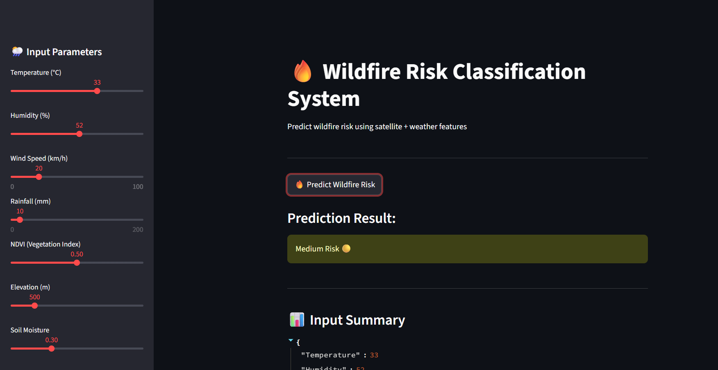
Streamlit Web Application
User Input
Weather params: Temp, RH, Wind, Rain, Indices
ML Prediction
XGBoost model processes inputs in real-time
Risk Output
Low / Medium / High wildfire risk classification
APP URL : https://wildfireriskclassificationfromsatelliteandweatherdata-8f7vgejc.streamlit.app/

Slide 9

Conclusion & Future Scope
CONCLUSION
FUTURE SCOPE
ML effectively predicts wildfire risk levels
Real-time Satellite Integration
Live NASA MODIS data feeds
XGBoost achieved 97.5% accuracy
Deep Learning Models
CNN/LSTM for spatial-temporal patterns
Predictive analytics aids disaster management
IoT Sensor Networks
Ground sensor data integration
System is deployment-ready via Streamlit
Live Dashboard
Real-time wildfire monitoring UI
"Technology can help save forests and lives."
— Thank You

